Slide 1













8th annual
Earth System Grid Federation
The ES-DOC Workflow for CMIP6
Mark Greenslade (IPSL)
Eric Guilyardi (IPSL)
Charlotte Pascoe (STFC)
David Hassell (NCAS)
December 5th, 2018
Outline
Overview
Experiments
Models
Ensembles
Summary

Slide 2
Overview | Experiments | Models | Ensembles | Summary
Overview

Slide 3
Overview | Experiments | Models | Ensembles | Summary
Core:
Eric Guilyardi (FR - IPSL/CNRS)
Mark Greenslade (FR - IPSL/CNRS)
David Hassell (UK - NCAS)
Charlotte Pascoe (UK - STFC)
Contributions:
Atef Ben Nasser (FR - IPSL)
Chris Blanton (US - GFDL)
Mark Elkington (UK - MOHC)
Ruth Petrie (UK - NCAS)
Ag Stephens (UK - STFC)
Allyn Treshansky (US - NOAA)
Martina Stockhausen (DE - DKRZ)
PI’s:
Balaji (US - GFDL)
Sébastien Denvil (FR - IPSL/CNRS)
Bryan Lawrence (UK - NCAS)
Cecelia De Luca (US - NOAA)
Karl Taylor (US - PCMDI)

Slide 4
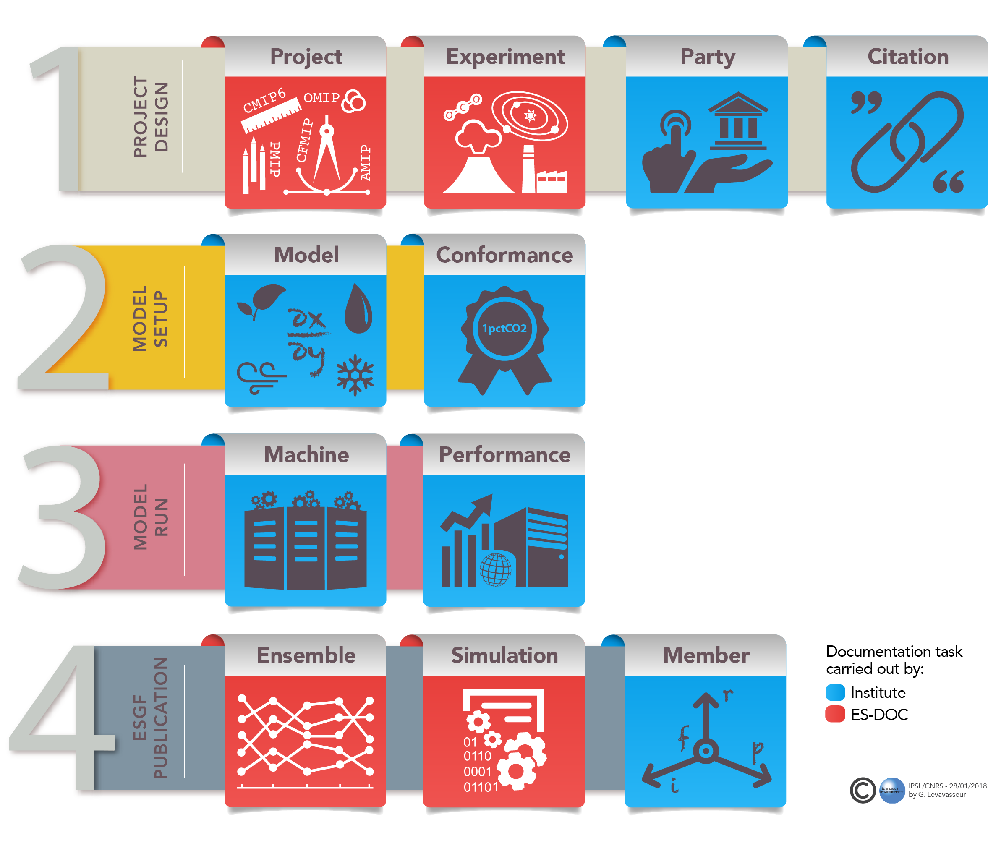
Overview | Experiments | Models | Ensembles | Summary

Slide 5
Overview | Experiments | Models | Ensembles | Summary
Experiments

Slide 6
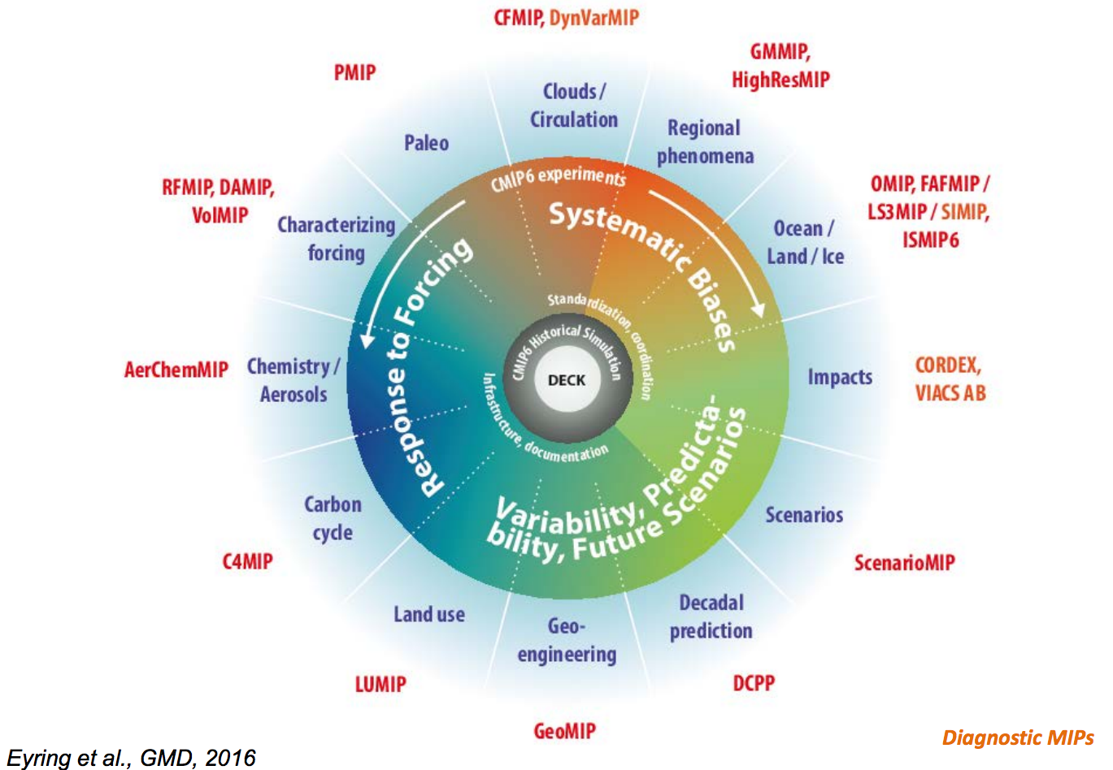
Overview | Experiments | Models | Ensembles | Summary

Slide 7
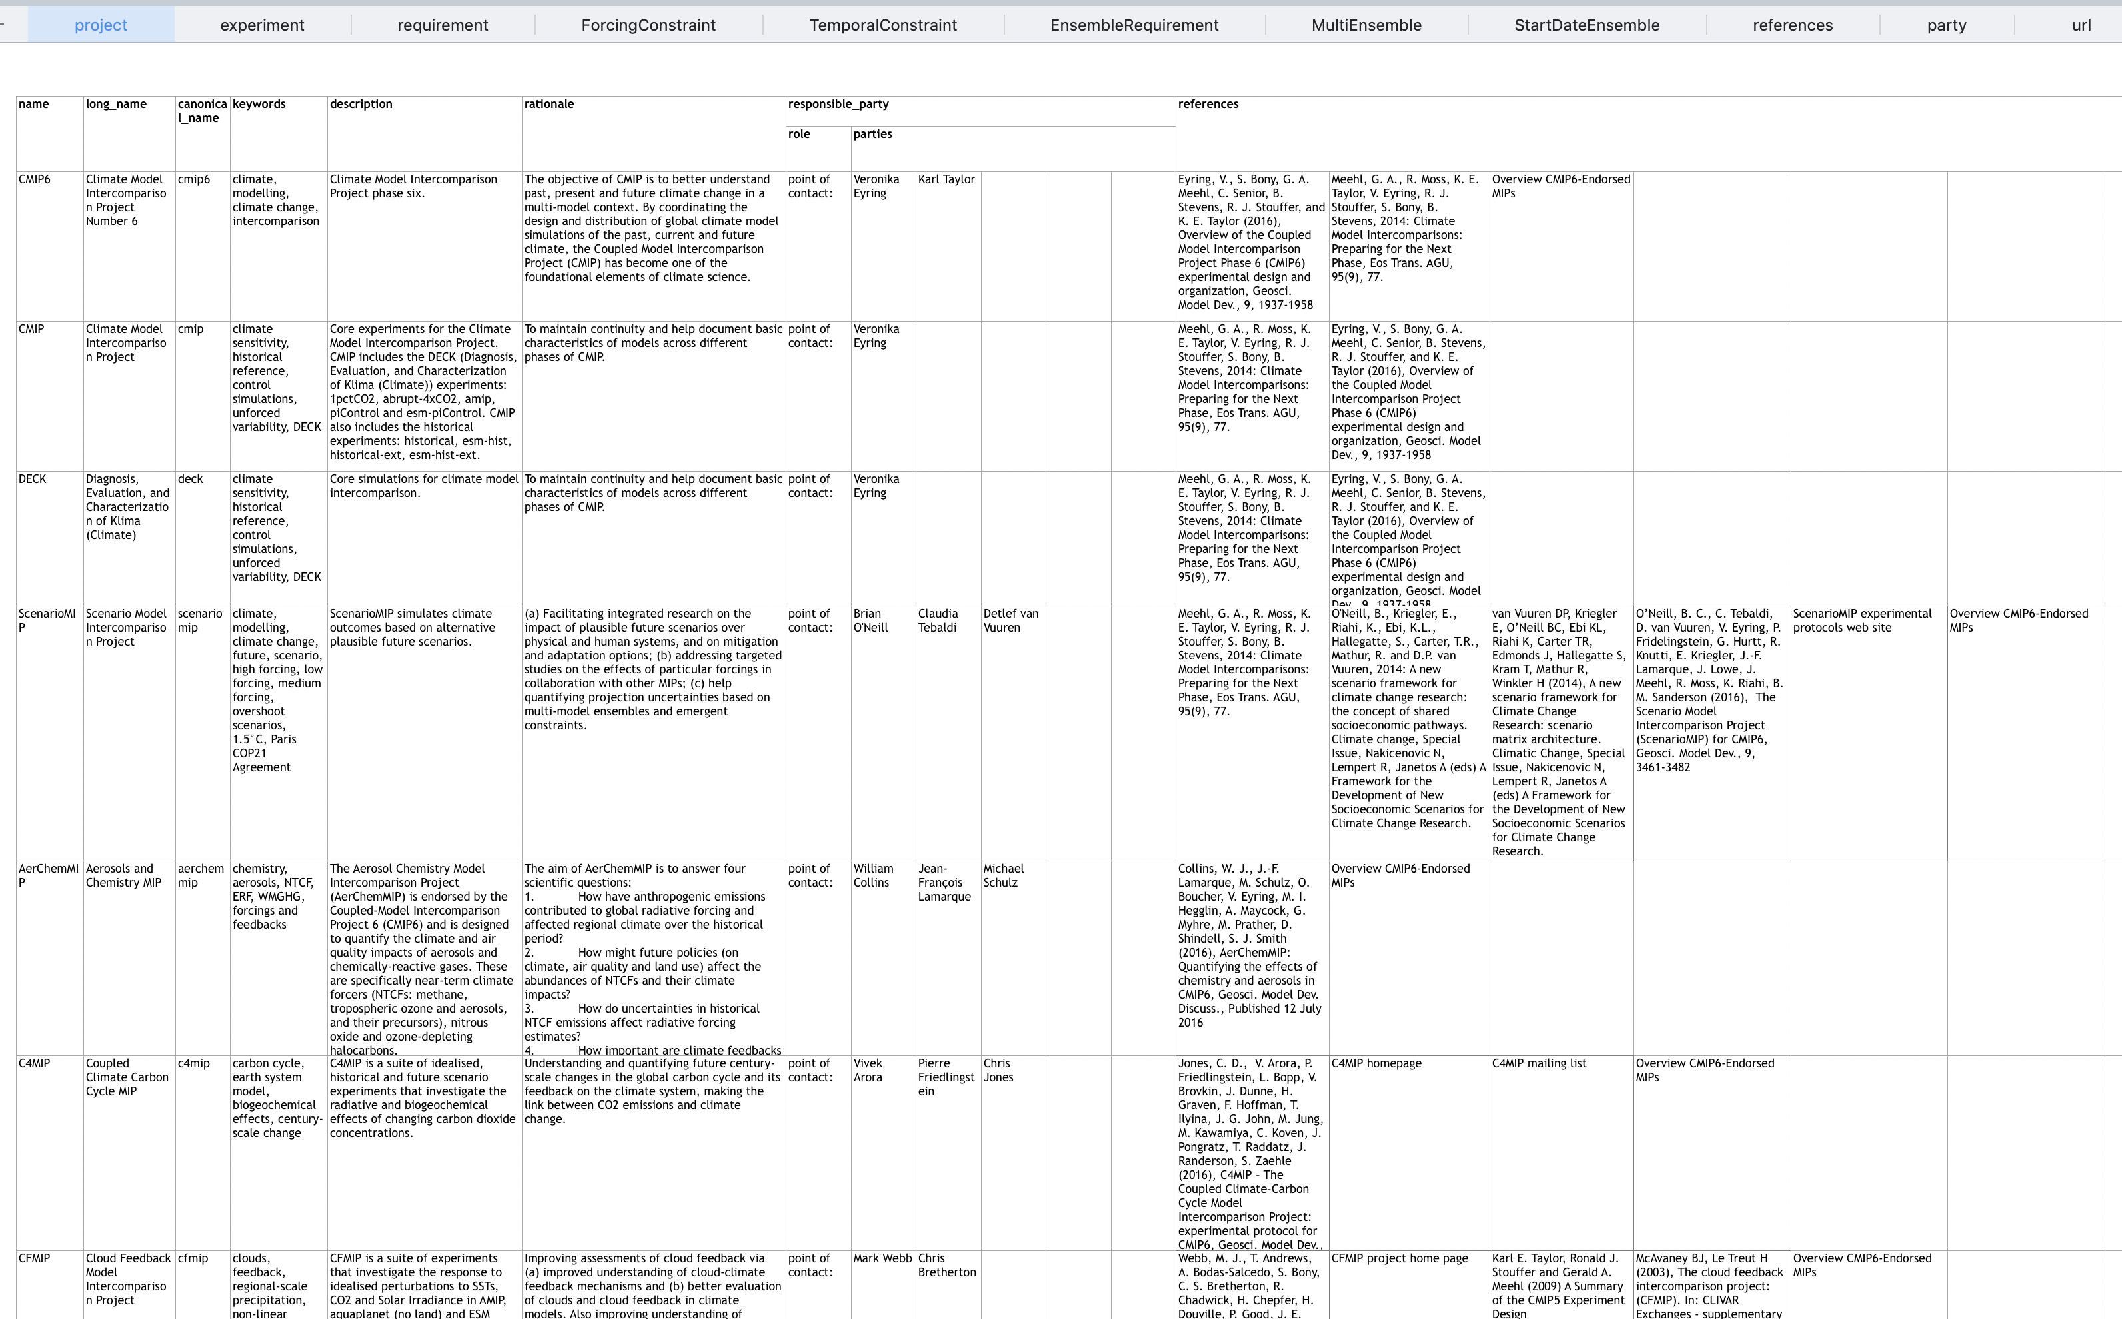
Overview | Experiments | Models | Ensembles | Summary
THE MOTHER OF ALL SPREADSHEETS !

Slide 8
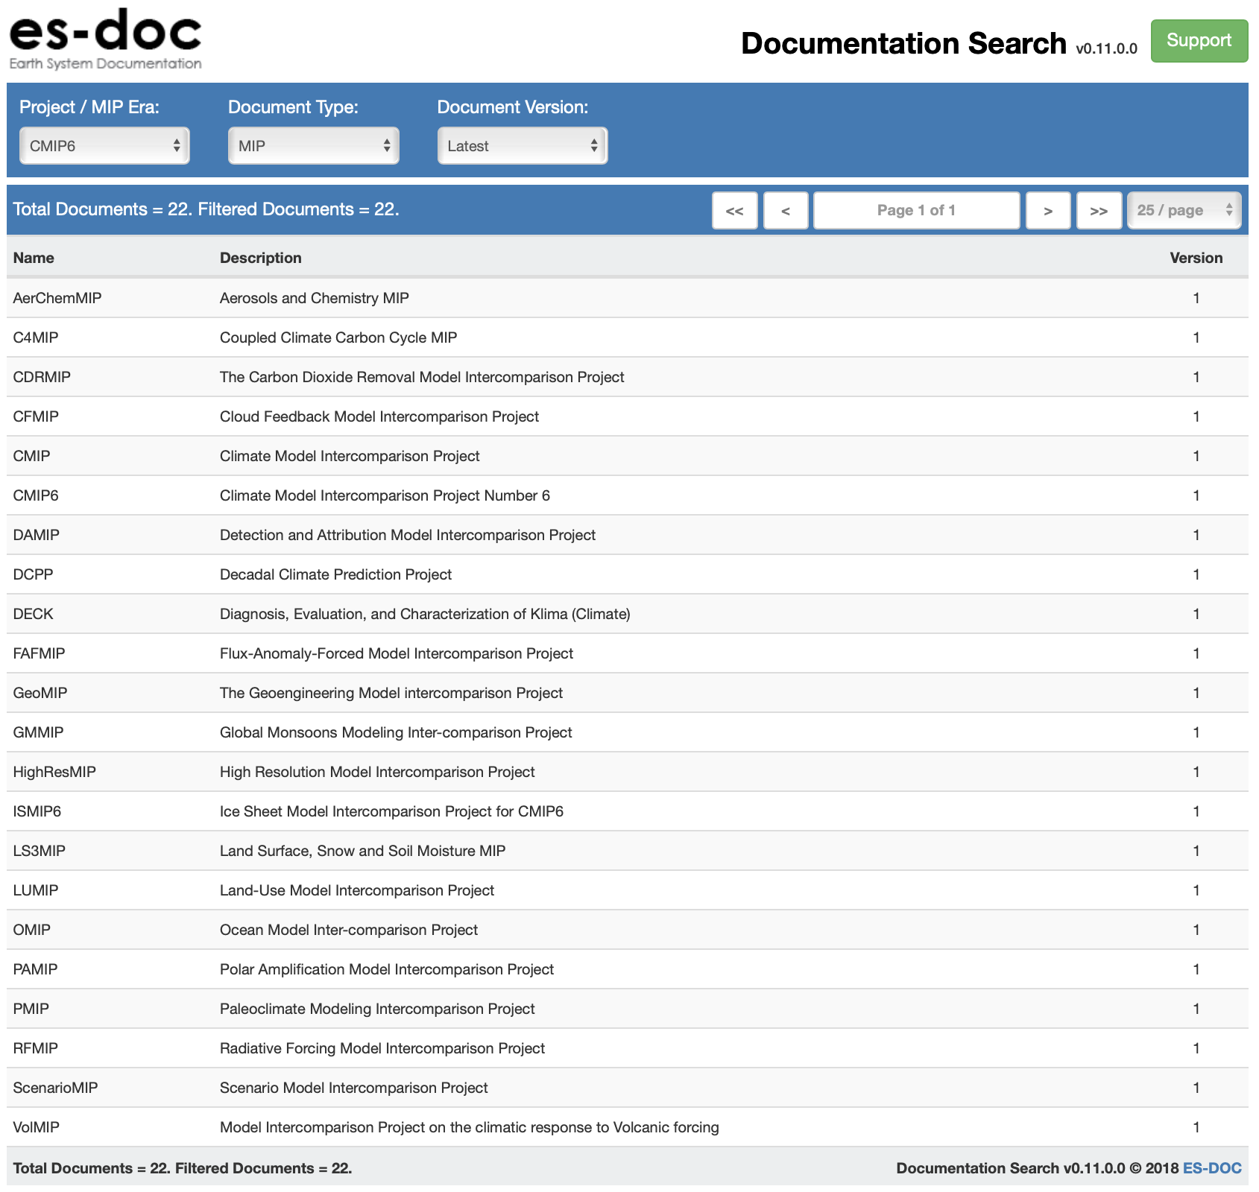
Overview | Experiments | Models | Ensembles | Summary
https://documentation.es-doc.org/cmip6

Slide 9
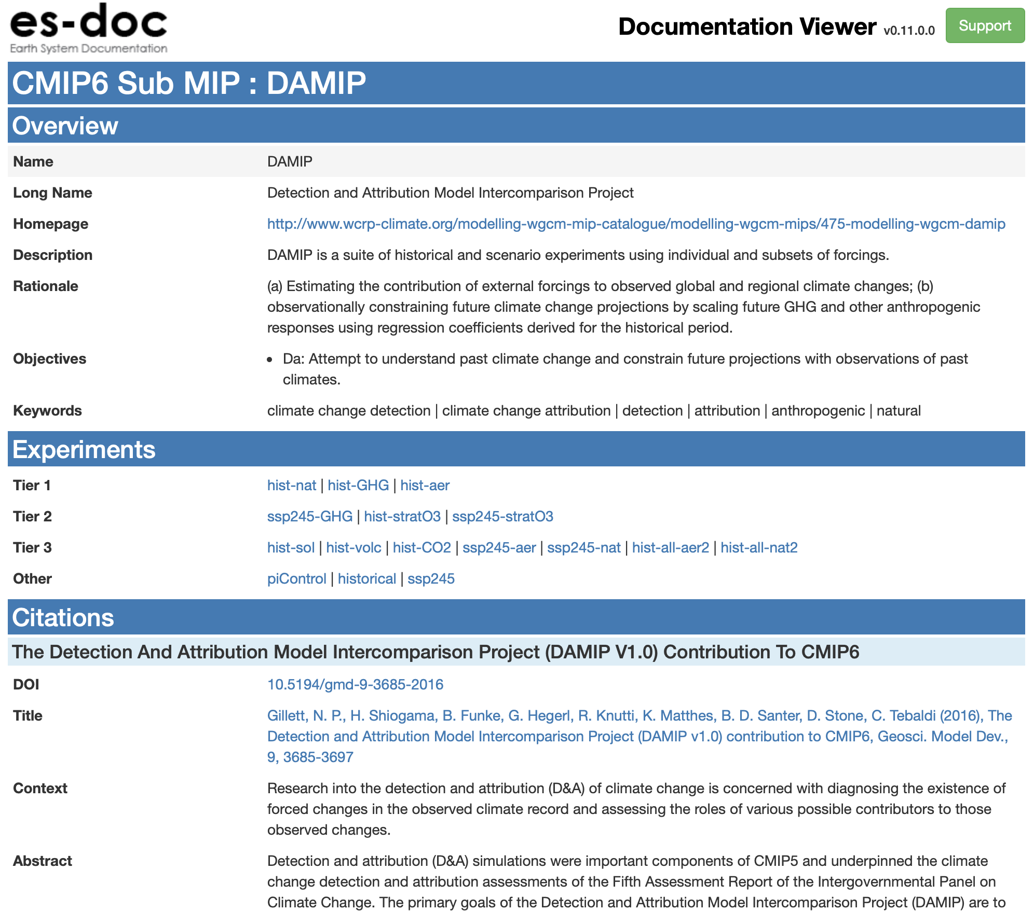
Overview | Experiments | Models | Ensembles | Summary
https://documentation.es-doc.org/cmip6/mips/damip

Slide 10
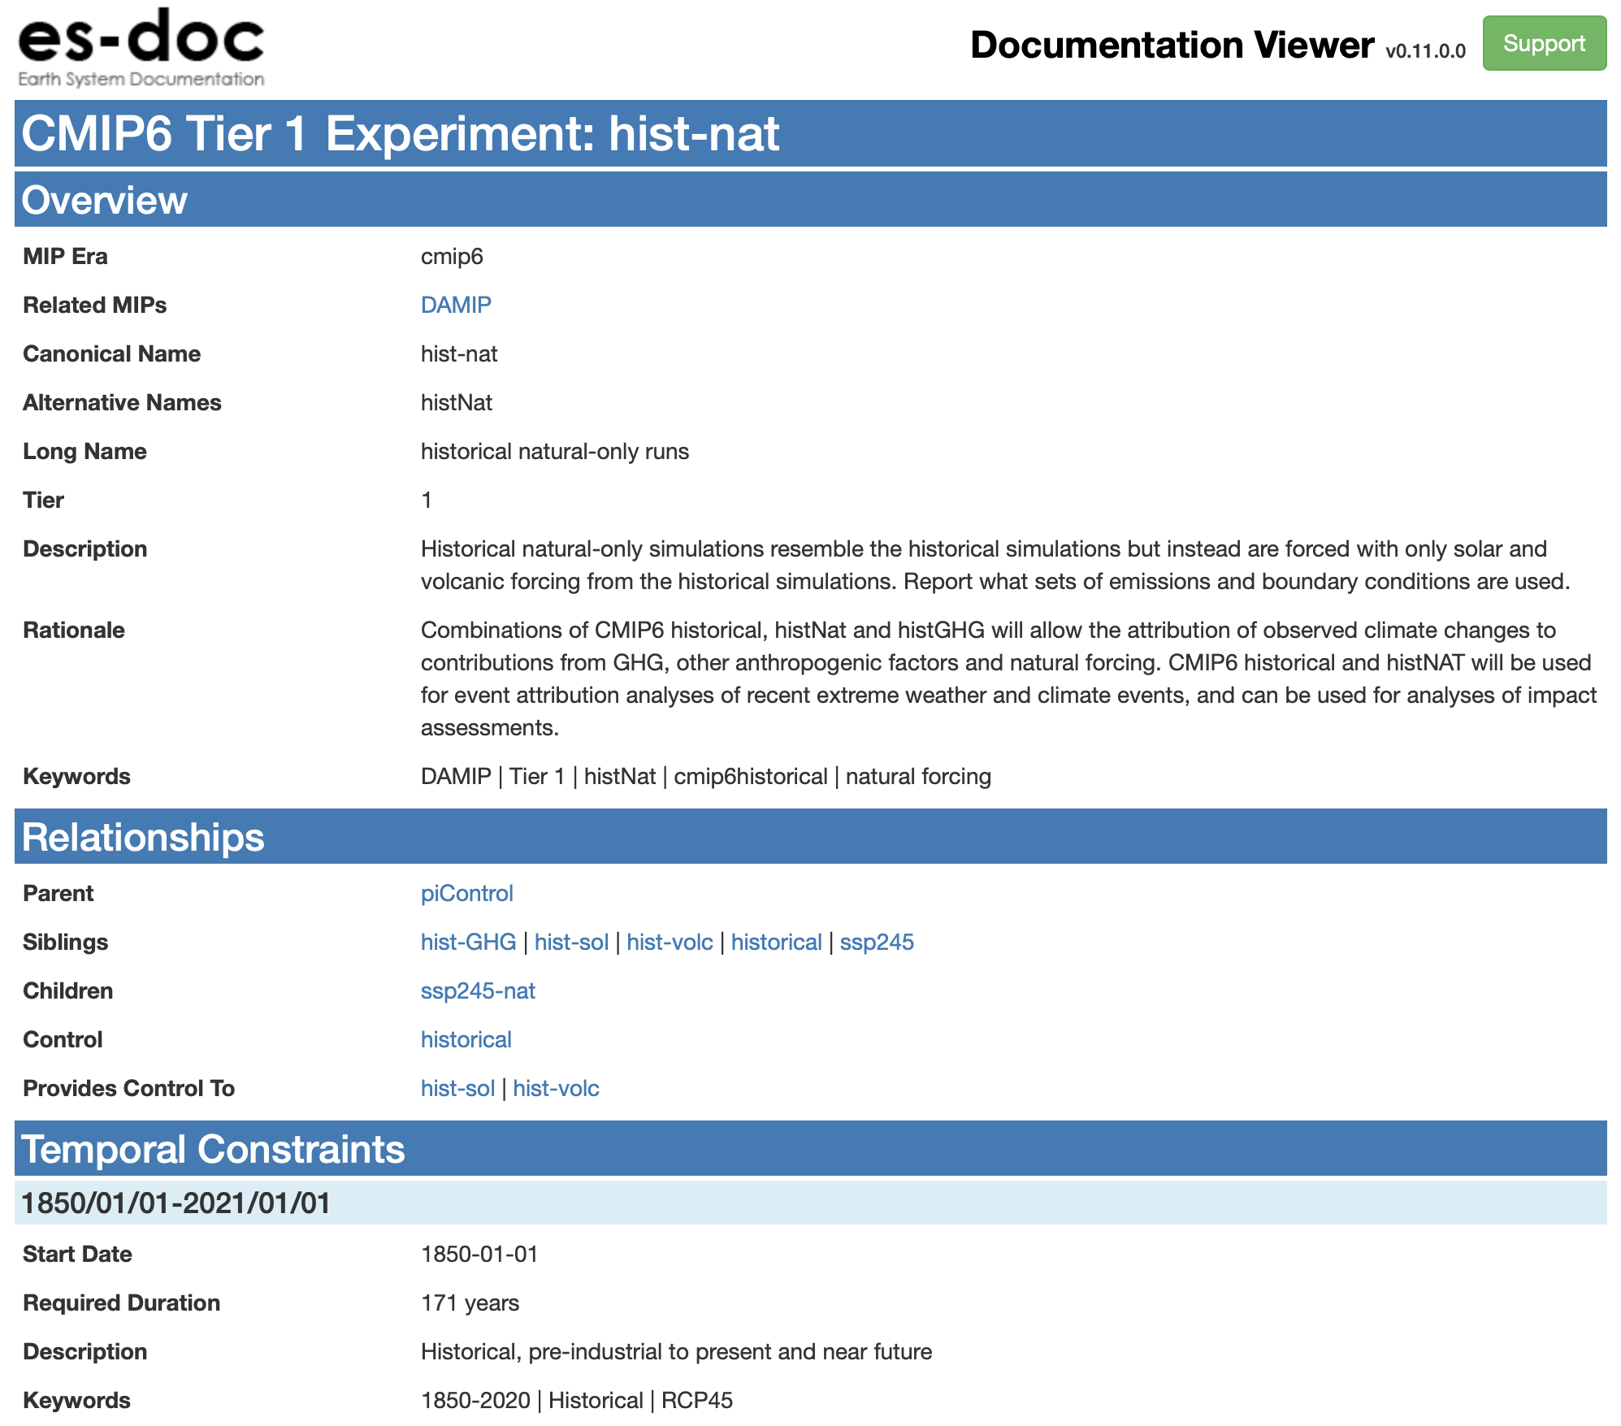
Overview | Experiments | Models | Ensembles | Summary
https://documentation.es-doc.org/cmip6/experiments/hist-nat

Slide 11
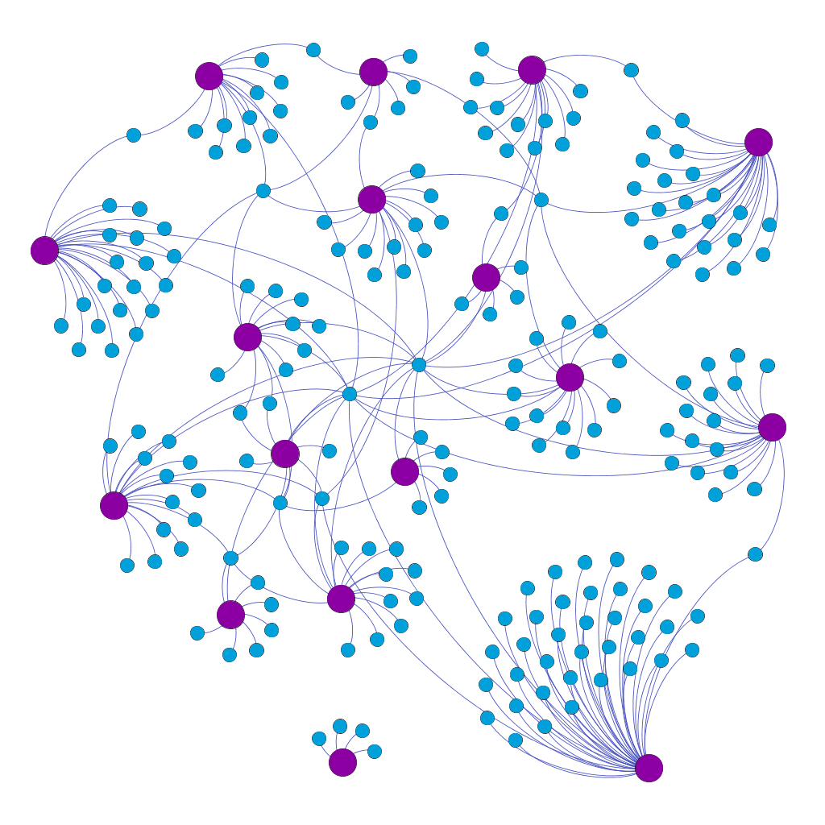
Overview | Experiments | Models | Ensembles | Summary
ScenarioMIP
VolMIP
LS3MIP
DCPP
LUMIP
GEOMIP
ssp245
ssp585
PMIP
C4MIP
DAMIP
piControl
CMIP
historical
FAFMIP
RFMIP
ISMIP6
amip
HighResMIP
GMMIP
AerChemMIP
OMIP

Slide 12
Overview | Experiments | Models | Ensembles | Summary
Models

Slide 13
Overview | Experiments | Models | Ensembles | Summary
Models: Specialisations

Slide 14
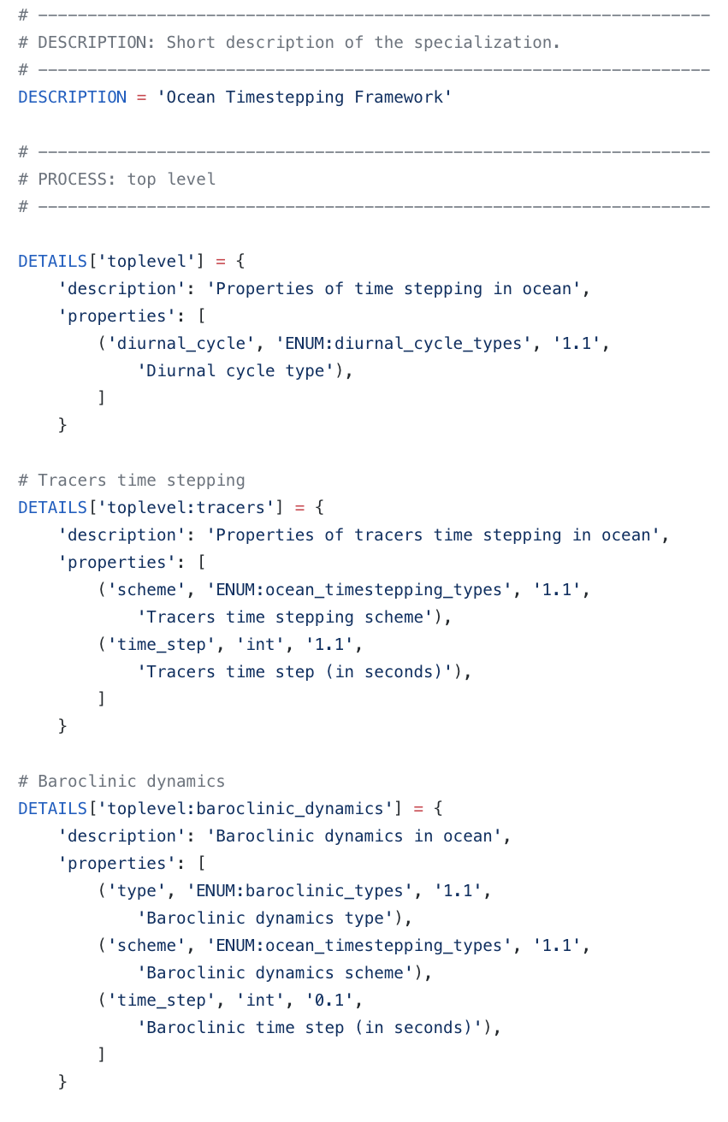

Overview | Experiments | Models | Ensembles | Summary
Experts define specialisations around a topic
Driven by scientists
One specialisation per CMIP6 realm + top-level
Tooling validates specialisations
Tooling generates downstream artefacts
WGCM short-table subsets

Slide 15
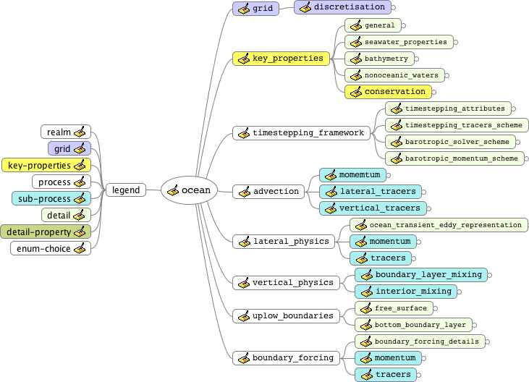
Overview | Experiments | Models | Ensembles | Summary

Slide 16
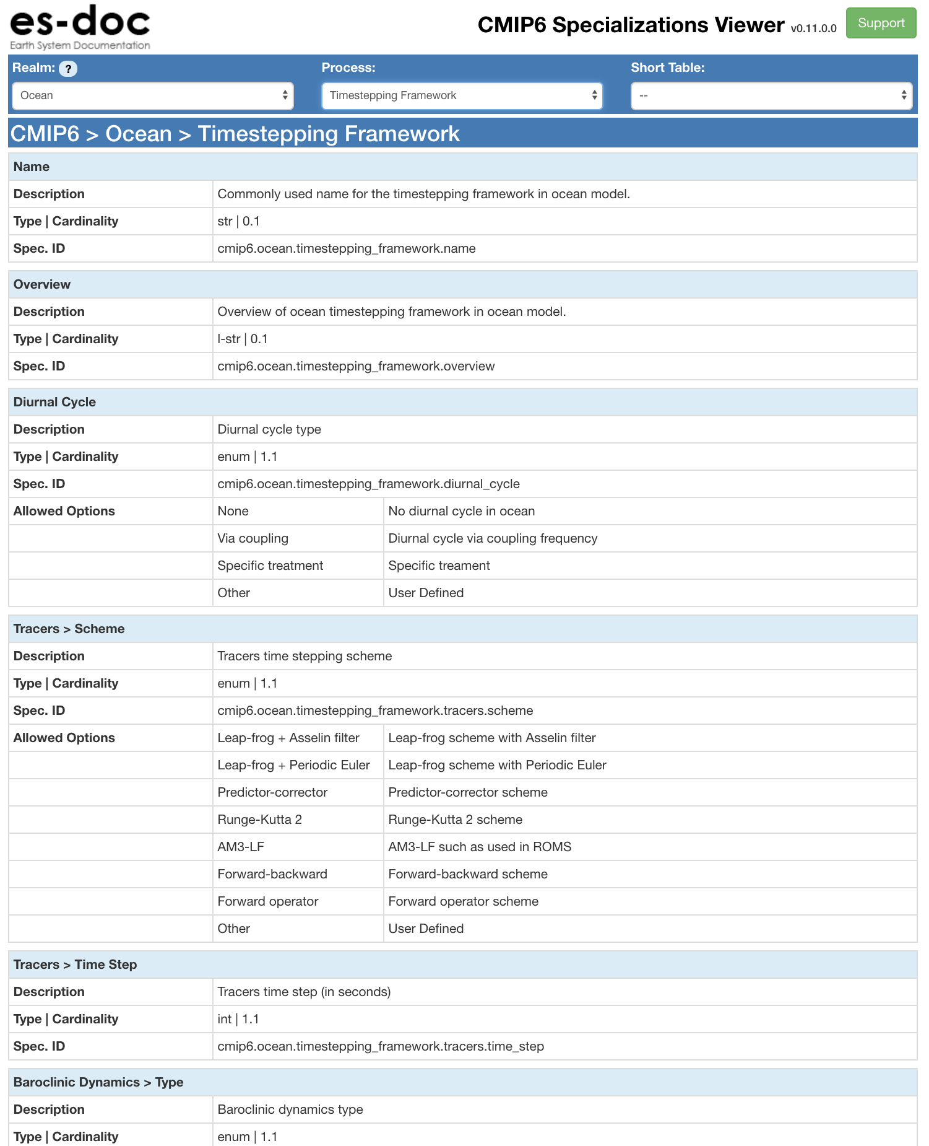
Overview | Experiments | Models | Ensembles | Summary
https://specializations.es-doc.org/cmip6

Slide 17
Overview | Experiments | Models | Ensembles | Summary
Models: Documenting

Slide 18
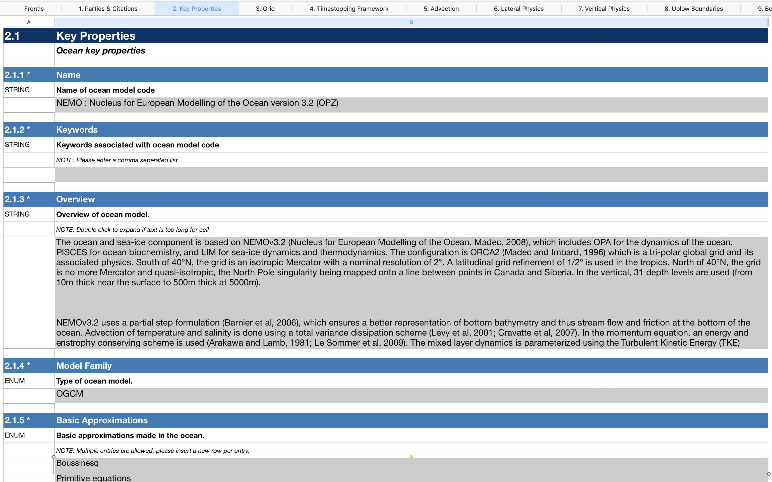
Overview | Experiments | Models | Ensembles | Summary
A spreadsheet per institute | source-ID | realm permutation

Slide 19
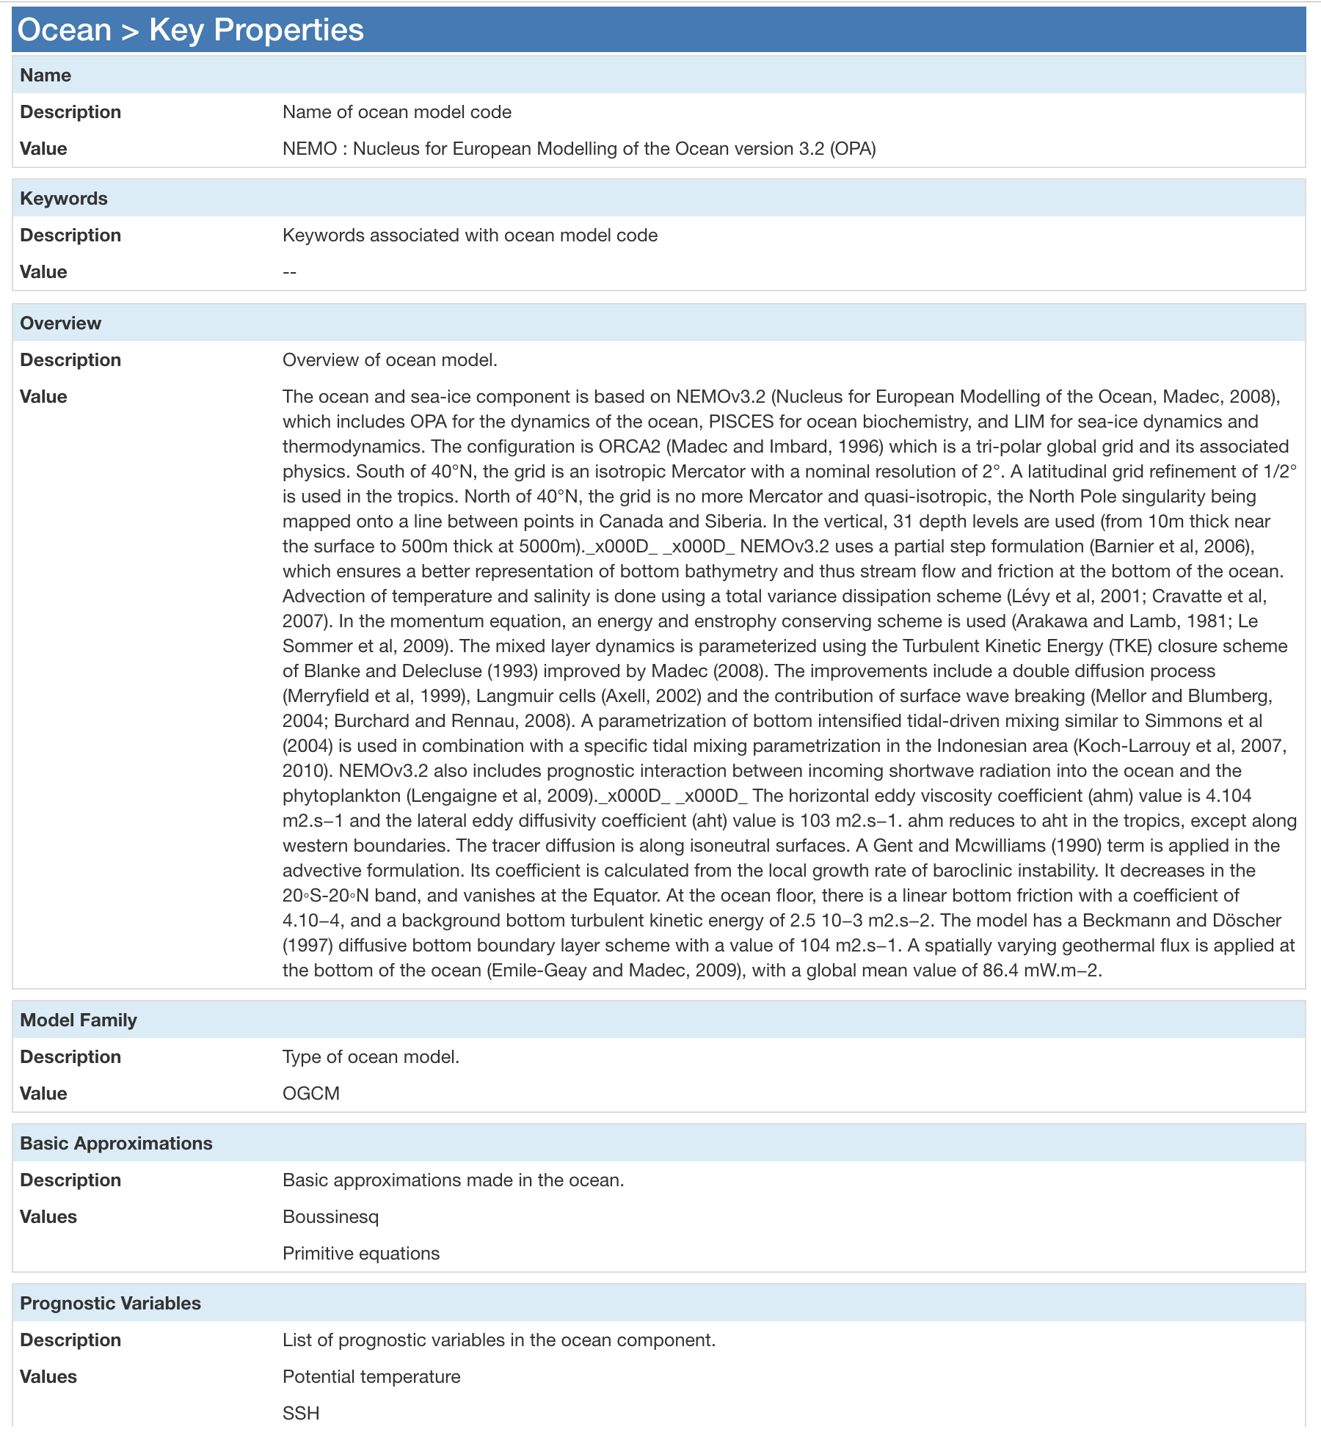
Overview | Experiments | Models | Ensembles | Summary
https://documentation.es-doc.org/cmip6/models/ipsl-cm6a-lr

Slide 20
Overview | Experiments | Models | Ensembles | Summary
Ensembles

Slide 21
Overview | Experiments | Models | Ensembles | Summary
Ensembles: Further Info URL

Slide 22
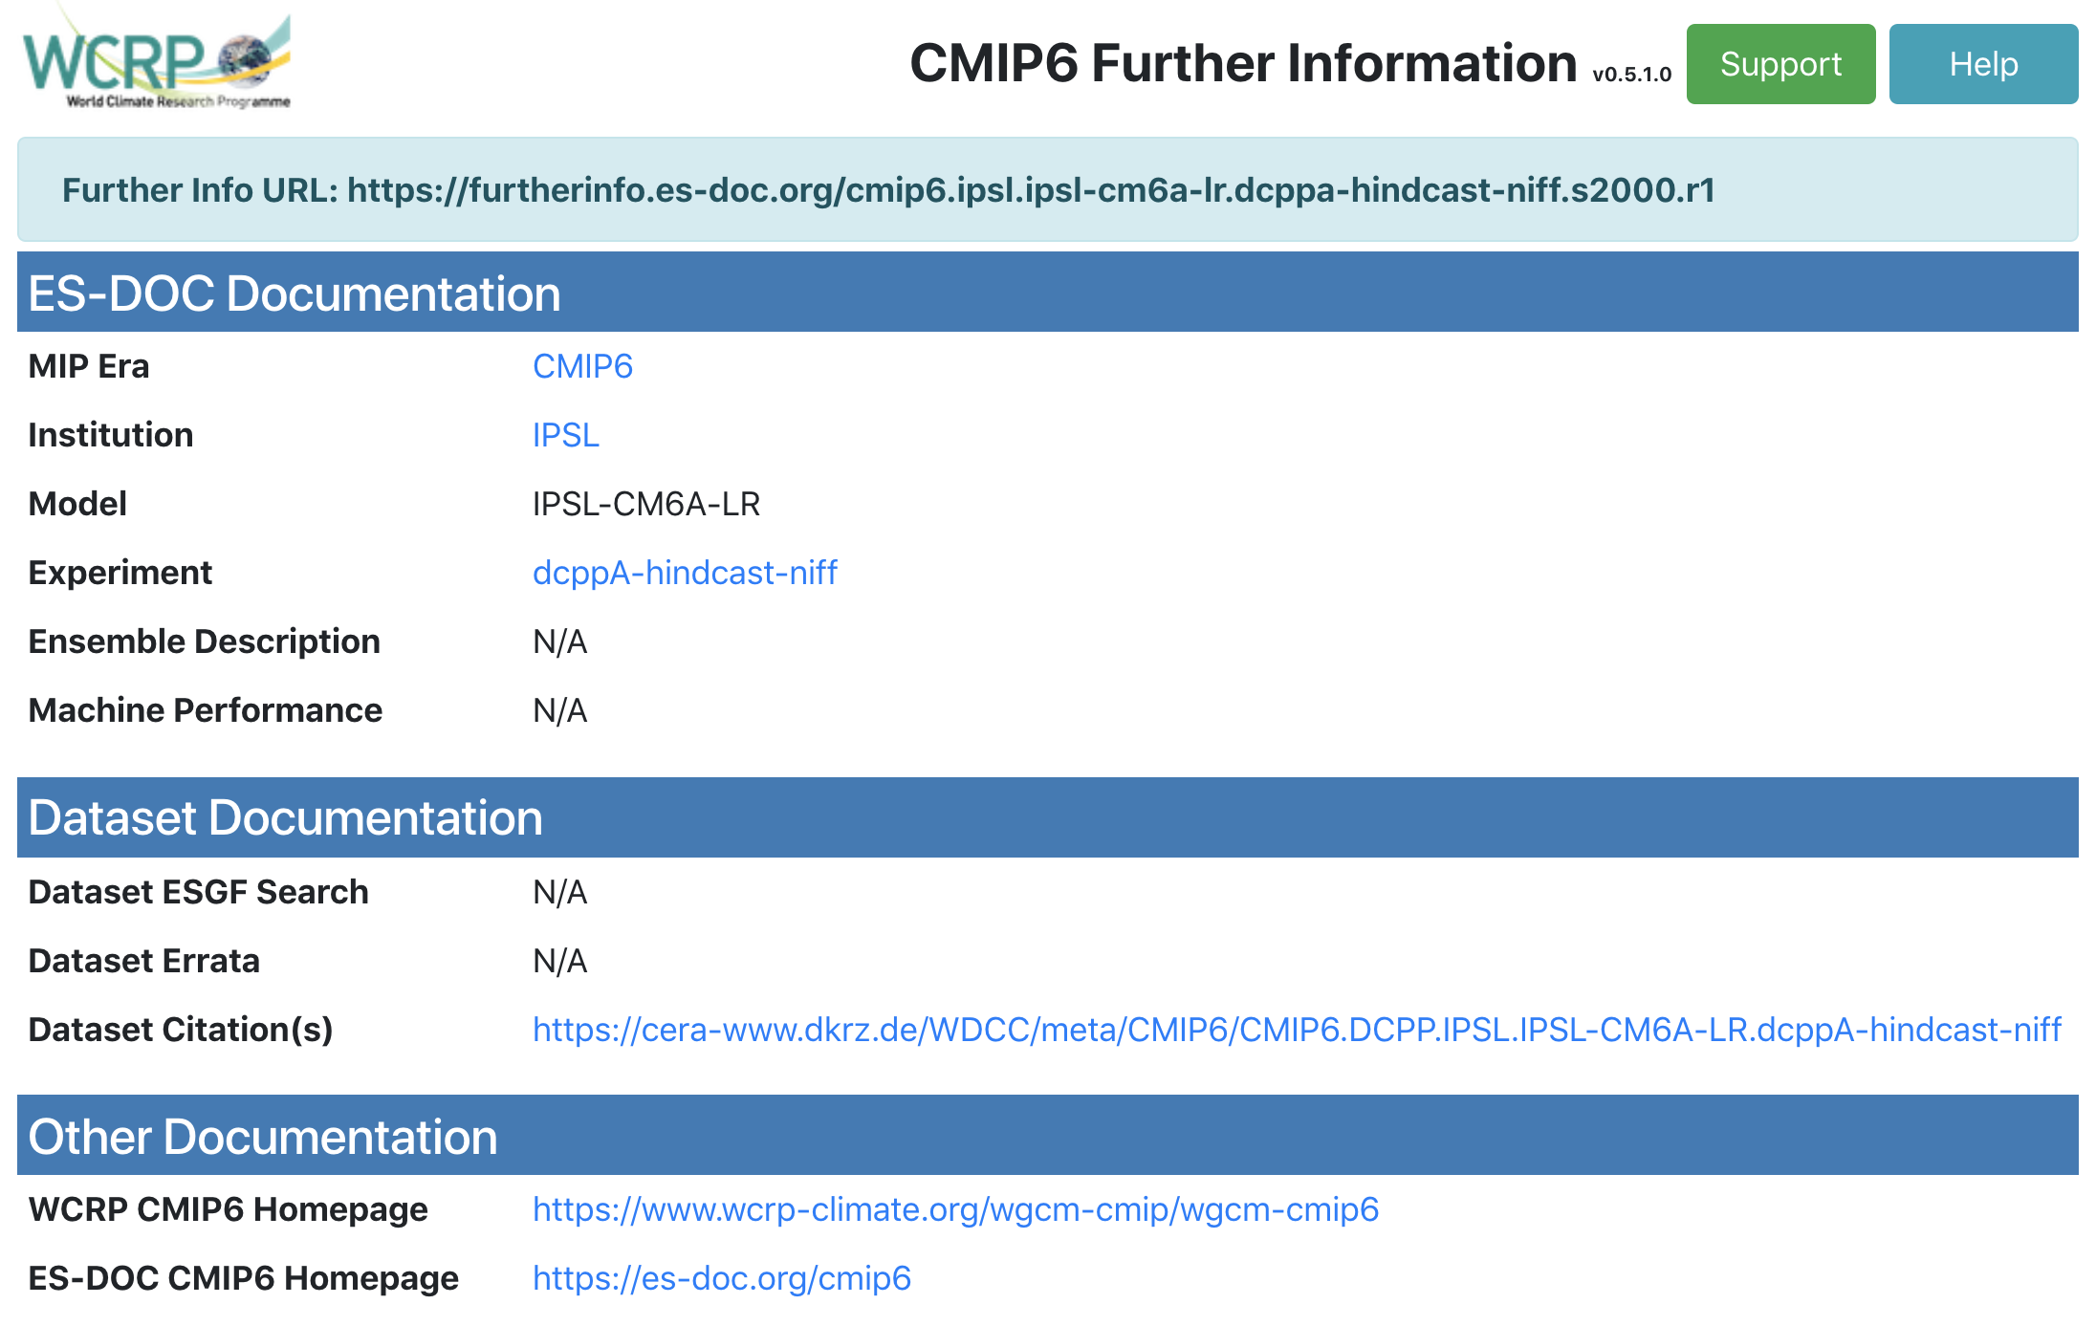
Overview | Experiments | Models | Ensembles | Summary
NetCDF headers contain a required attribute: further_info_url
https://furtherinfo.es-doc.org/<mip-era>.<institute-id>.<source-id>.<experiment-id>.<sub-experiment-id>.<variant-label>

Slide 23
Overview | Experiments | Models | Ensembles | Summary
Ensembles: Dataset Errata

Slide 24
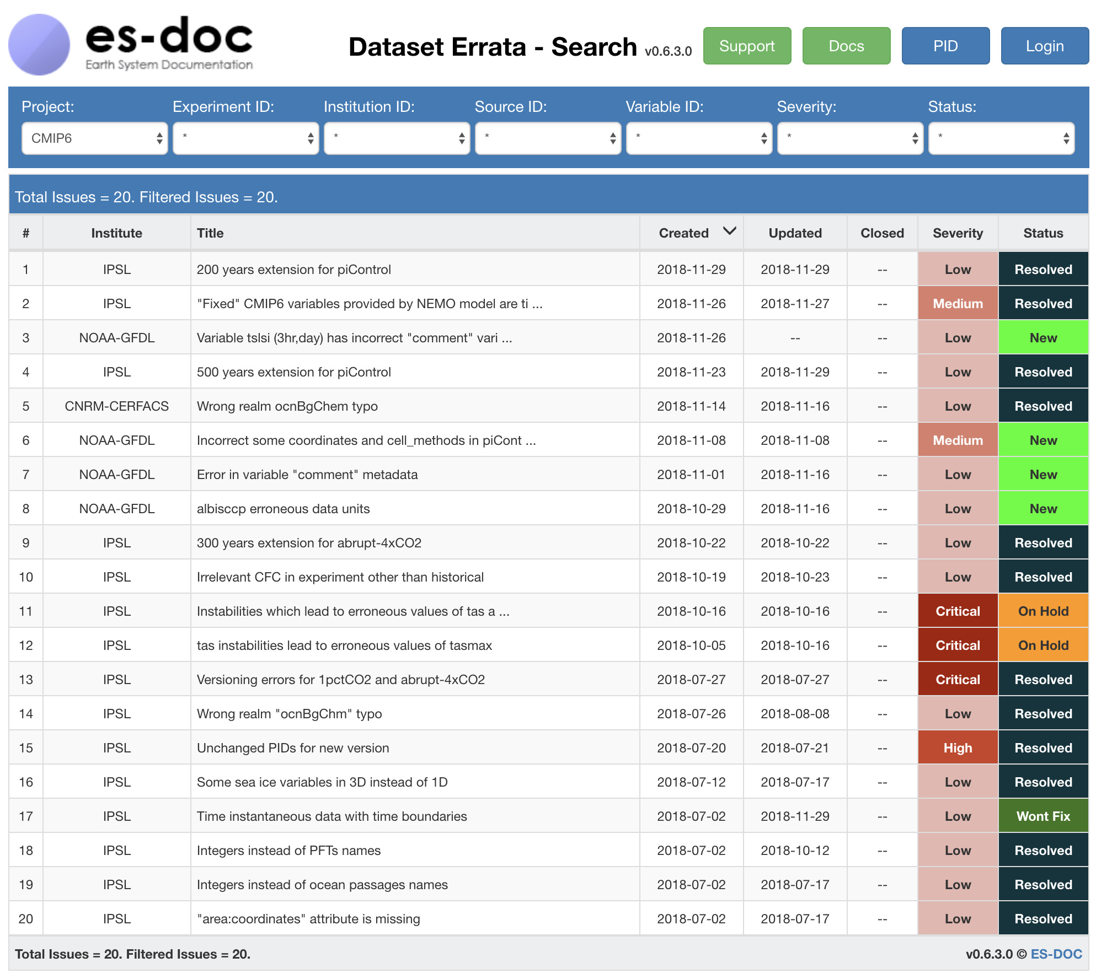
Overview | Experiments | Models | Ensembles | Summary
https://errata.es-doc.org

Slide 25
Overview | Experiments | Models | Ensembles | Summary
Ensembles: Conformances

Slide 26

Overview | Experiments | Models | Ensembles | Summary
How do simulations conform to MIP protocols ?
Spreadsheet for default conformances that are
applicable to many experiments
Place in repo accessible by the institute
ES-DOC
Step 1: Common conformances declared within a default spreadsheet
Step 2: Ensemble specific conformances declared within auto-initialised spreadsheets
Institute
Enter default conformance info
Harvest default conformances for further spreadsheets
One for every Model+MIP combo
Place in repo accessible by the institute
N-step process
ES-DOC
Step 3: Merge common + ensemble specific conformances
Step 4: Transform spreadsheets into CIM documents and publish
Enter conformance info for unique requirements and override default conformances
Institute
Harvest the actual conformances, for every Model+MIP and create CIM2 conformance documents
ES-DOC

Slide 27
Overview | Experiments | Models | Ensembles | Summary
Ensembles: CDF 2 CIM

Slide 28
Overview | Experiments | Models | Ensembles | Summary
cdf2cim client library:
cf-python
cdf2cim web-service
esg-f publisher integration:
—cdfcim flag
scan directory
map/reduce netCDF —> JSON
write JSON to fs
publish JSON to ws
security:
GitHub API
cdf2cim-publication GitHub team
Web-service:
map JSON —> CIM
publish to tools: search & view.

Slide 29
Overview | Experiments | Models | Ensembles | Summary
Summary

Slide 30
Overview | Experiments | Models | Ensembles | Summary
Evolutionary:
Building upon CMIP5 documentation
Automated:
Where feasible
Mandated:
WGCM via WIP
Simplified:
Spreadsheets + scripts
Sustainable:
EU funding via CNRS/IPSL & ISENES3
Great team:
Long term collaboration

Slide 31
Overview | Experiments | Models | Ensembles | Summary

Slide 32
8th annual
Earth System Grid Federation
The ES-DOC Workflow for CMIP6
Mark Greenslade (IPSL)
Eric Guilyardi (IPSL)
Charlotte Pascoe (STFC)
David Hassell (NCAS)
December 5th, 2018
Outline
Overview
Experiments
Models
Ensembles
Summary

